Slide 1
THE VAWT (RE)
The students of 1st B.tech CIVIL and MECHANCAL teamed up as
Civimechos
MENTORS: Dr . JAGDISH VENGALA & Dr. A HARITHA
TEAM MEMBERS: HEMA VARSHINI
MADHAVA RAO
KUSUMA SUCHITHA
SAI SANKARAN
VIKAS DASS
HARSHA M
Presenting:
PVP SIDDARTHA INSTITUTE OF TECHNOLOGY, VIJAYAWADA,ADHRA PRADESH

Slide 2
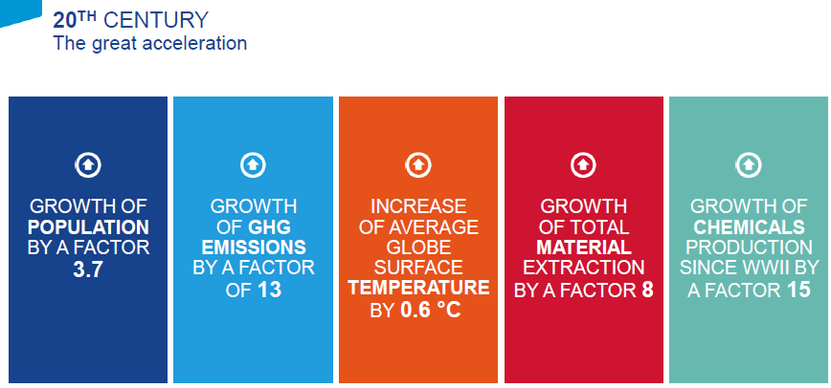
WHY RENEWABLE ENERGY?

Slide 3

.00000000000000

Slide 4
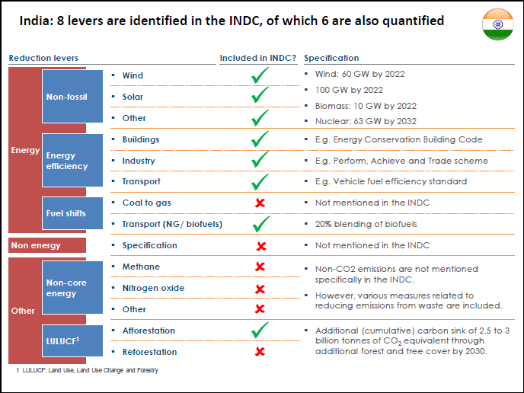
GOALS
SOLUTION??????

Slide 5
SOLUTION – SWITCH TO RENEWABLE ENERGY

Slide 6
WIND TURBINES
WIND TURBINES ARE GOIND ON HIGH DEMAND AS THE SWITCH TO RENEWABLE ENERGY IS PROGRESS
THIS PROJECT AIMS IN UTILIZING THIS WIND ENERGY IN LOST EFFECTIVE MANNER TO GET THE MAXIMUM OUTPUT WITH MINIMUM COST INDULGES

Slide 7
WHY VAWT on HIGHWAYS
HAWT’S have a lot of limitations.
These are small and compact units which do not require more space for installation .
This turbine rotates in the same direction irrespective of the wind direction.
The helical twist is modified from the prior art and designed for INDIAN traffic flow(i.e. for right hand drive)

Slide 8
TYPE OF TURBINE: DRAG
In these wind turbines the force of the wind pushes against like an open sail, in the direction of wind flow.
It works because the drag of the concave face of the cylinder is greater than the drag on the closed or convex section.

Slide 9
COMPONENTS
SHAFT
BLADES
CONNECTING ROD
BEARINGS
ALTERNATOR
LOAD
STAND
RIVETS
CONNECTING SLEEVE

Slide 10
ROTOR
component | dimensions | reason
Total height of rotor | 1550mm | It is the ideal height from the ground On an average the maximum wind flow when a vehicle passes is at this height.
Diameter of the rotor | 400mm | This is the maximum possible width with swept area to be installed on a highway divider
Material used | 22gauge Aluminum sheet & 1 inch aluminum pipe | Light in weight and non corrosive in nature.

Slide 11
Blades
Component | Dimensions | Reason
No.of blades | 10 blades. 5 on each side | For the given radius of the rotor this is the maximum swept area.
Helical shape | 120 degrees helical twist | To allow the rotation of the blades in the same direction irrespective of the wind speed.
painted | ------------------- | Surface sprayed. Strong corrosion resistance, durable and beautiful.

Slide 12
BEARINGS
COMPONENT | REASON
Type of bearings | Flange bearings(F205)
Dual bearing | Low operating vibration & strong resistance
Flange mounting | Convenient installation and maintenance
FUNCTION: TO ALLOW THE FREE ROTATION OF THE SHAT.

Slide 13
ALTERNATOR
COMPONENT | DESCRIPTION | REASON
Type used | 12v helical geared alternator | LOW TORQUE LOW STARTUP SPEED HIGH WIND UTILIZATION LOW VIBRATION LOW NOISE
START UP SPEED = 3km/h
AVERAGE WIND SPEED ON HIGHWAYS = 10km/h (in worst case)
FUNCTION: CONVERT THE MECHANICAL ENERGY TO ELECTRICITY

Slide 14
BLOCK DIAGRAM FOR WORKING
L
O
A
D
BOOST CONVERTER
ALTERNATOR
BATTERY
VAWT

Slide 15
CALCULATIONS
We have used 12volts alternator which will generate 5volts with 100 milli ampere current.
Generated power is 0.5watt/sec
Our assumption of generated power per second
Calculations:
0.5W*60min*60sec=1800W/h
POWER GENERATED IN I HOUR IS -1unit (i.e. 60% of the total power generated)
Assume it generates 15 units per day
Taking hours of operation is 15 hours per day

Slide 16
Cost analysis
Cost of one turbine = 10,000 rupees
Assuming 1 unit =4 rupees
i.e we get 4rupees*15units = 60 rupees per day
PAYBACK PERIOD
Amount invested=10000 rupees
We get 60 rupees per day
i.e.10000/60 =166 days
Hence you get the money invested within 7months in worst case

